Slide 1
Website Evaluation & Redesign Proposal
eCampus IT Programming Website
Team Members:
Joshua Xie
Tonglin Yang
Mar 27 – Apr 5, 2026

Slide 2
Introduction
• This project analyzes the eCampus IT Programming website
• The evaluation focuses on user experience, design, and usability
• Key problems are identified and analyzed
• Solutions are proposed to improve the overall experience

Slide 3
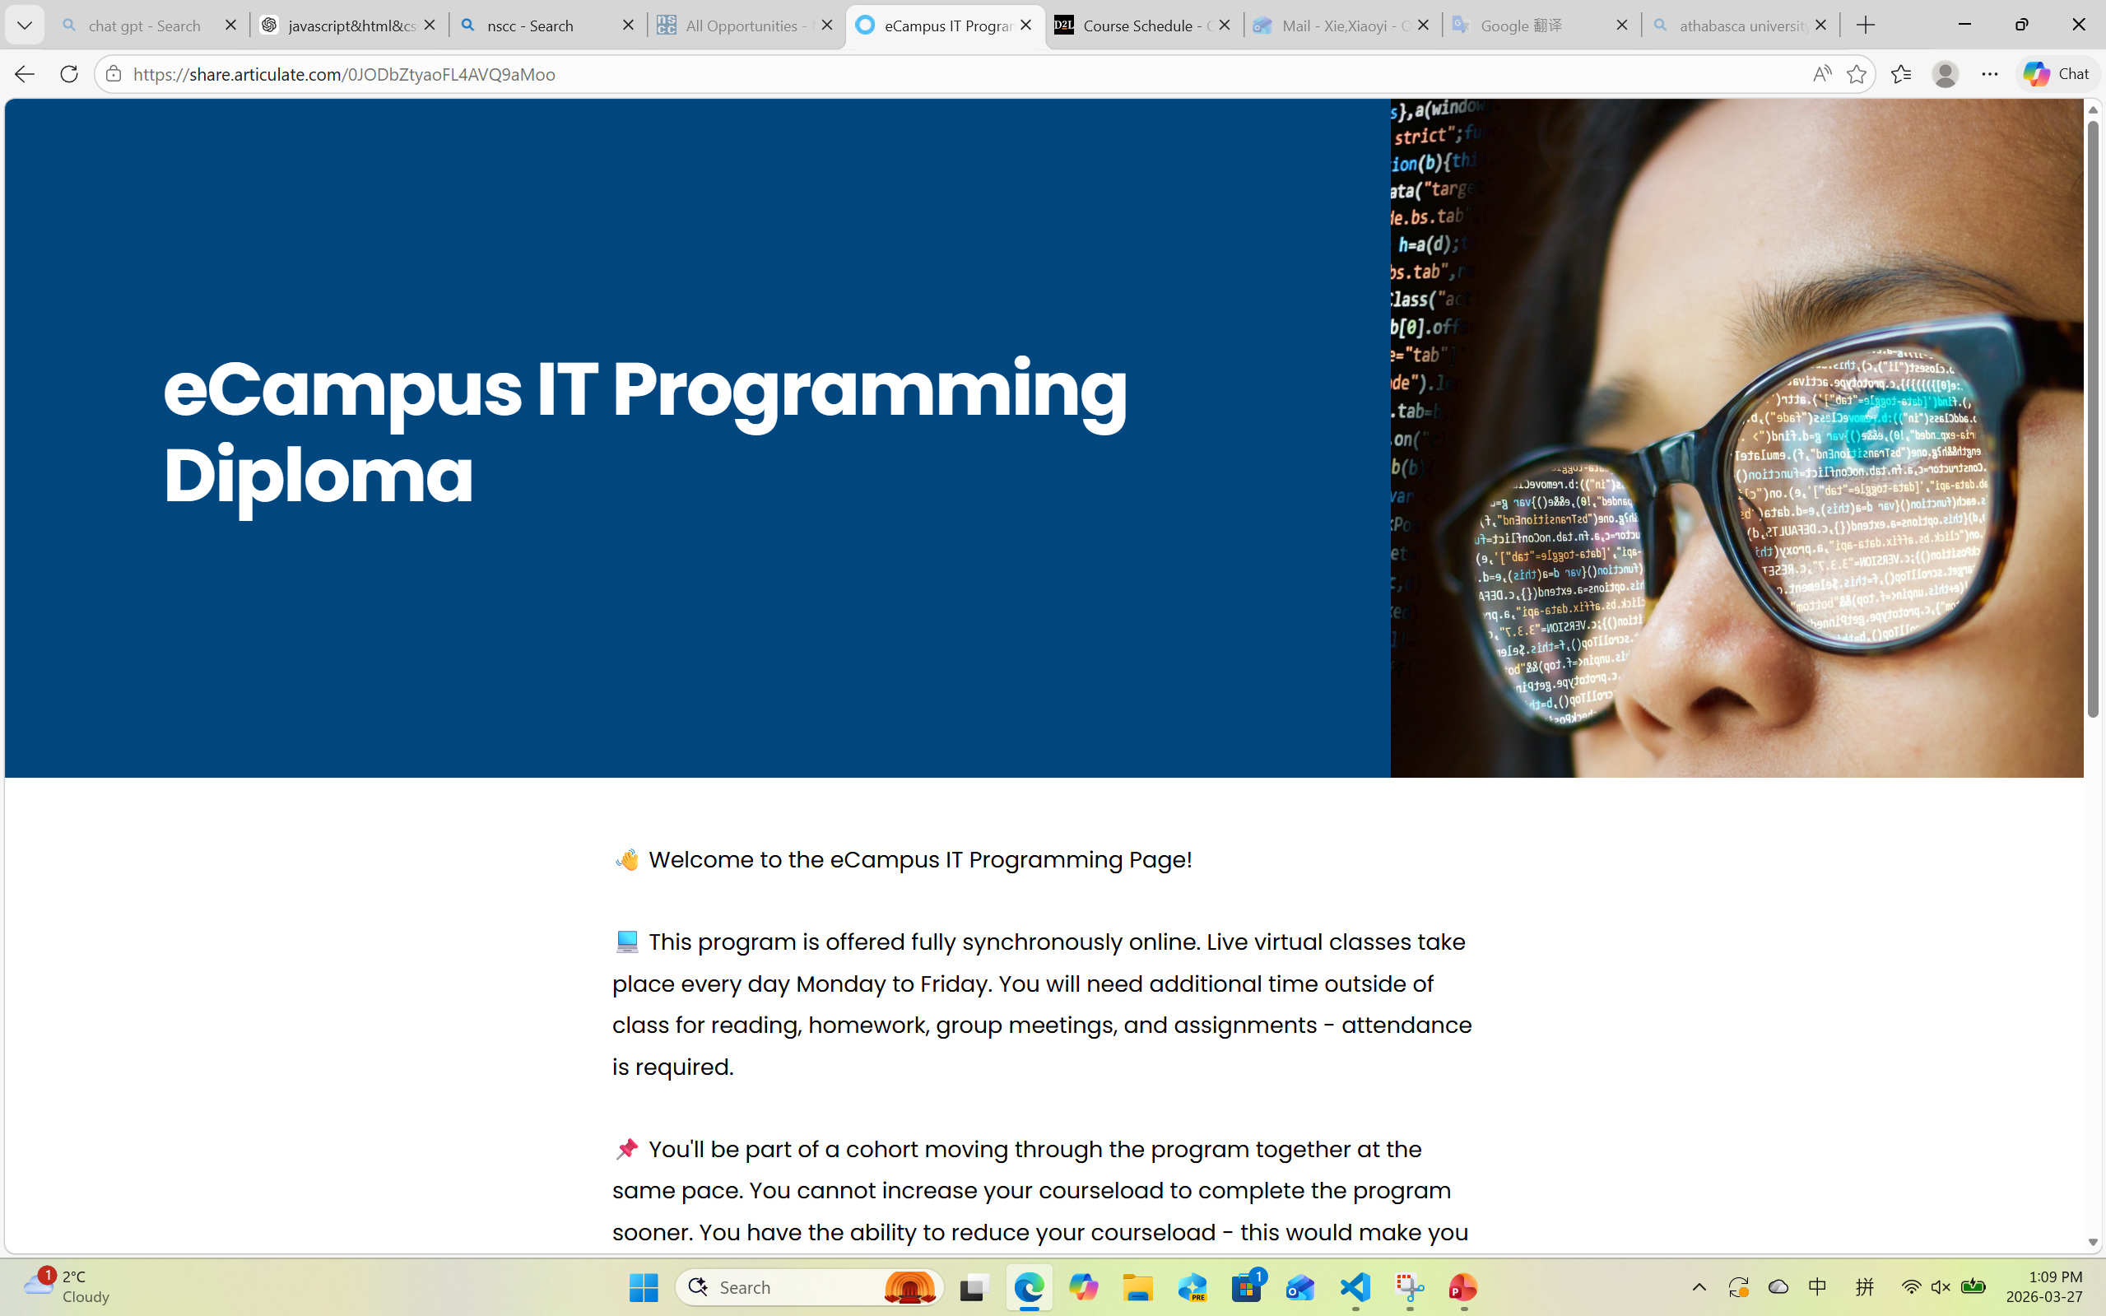
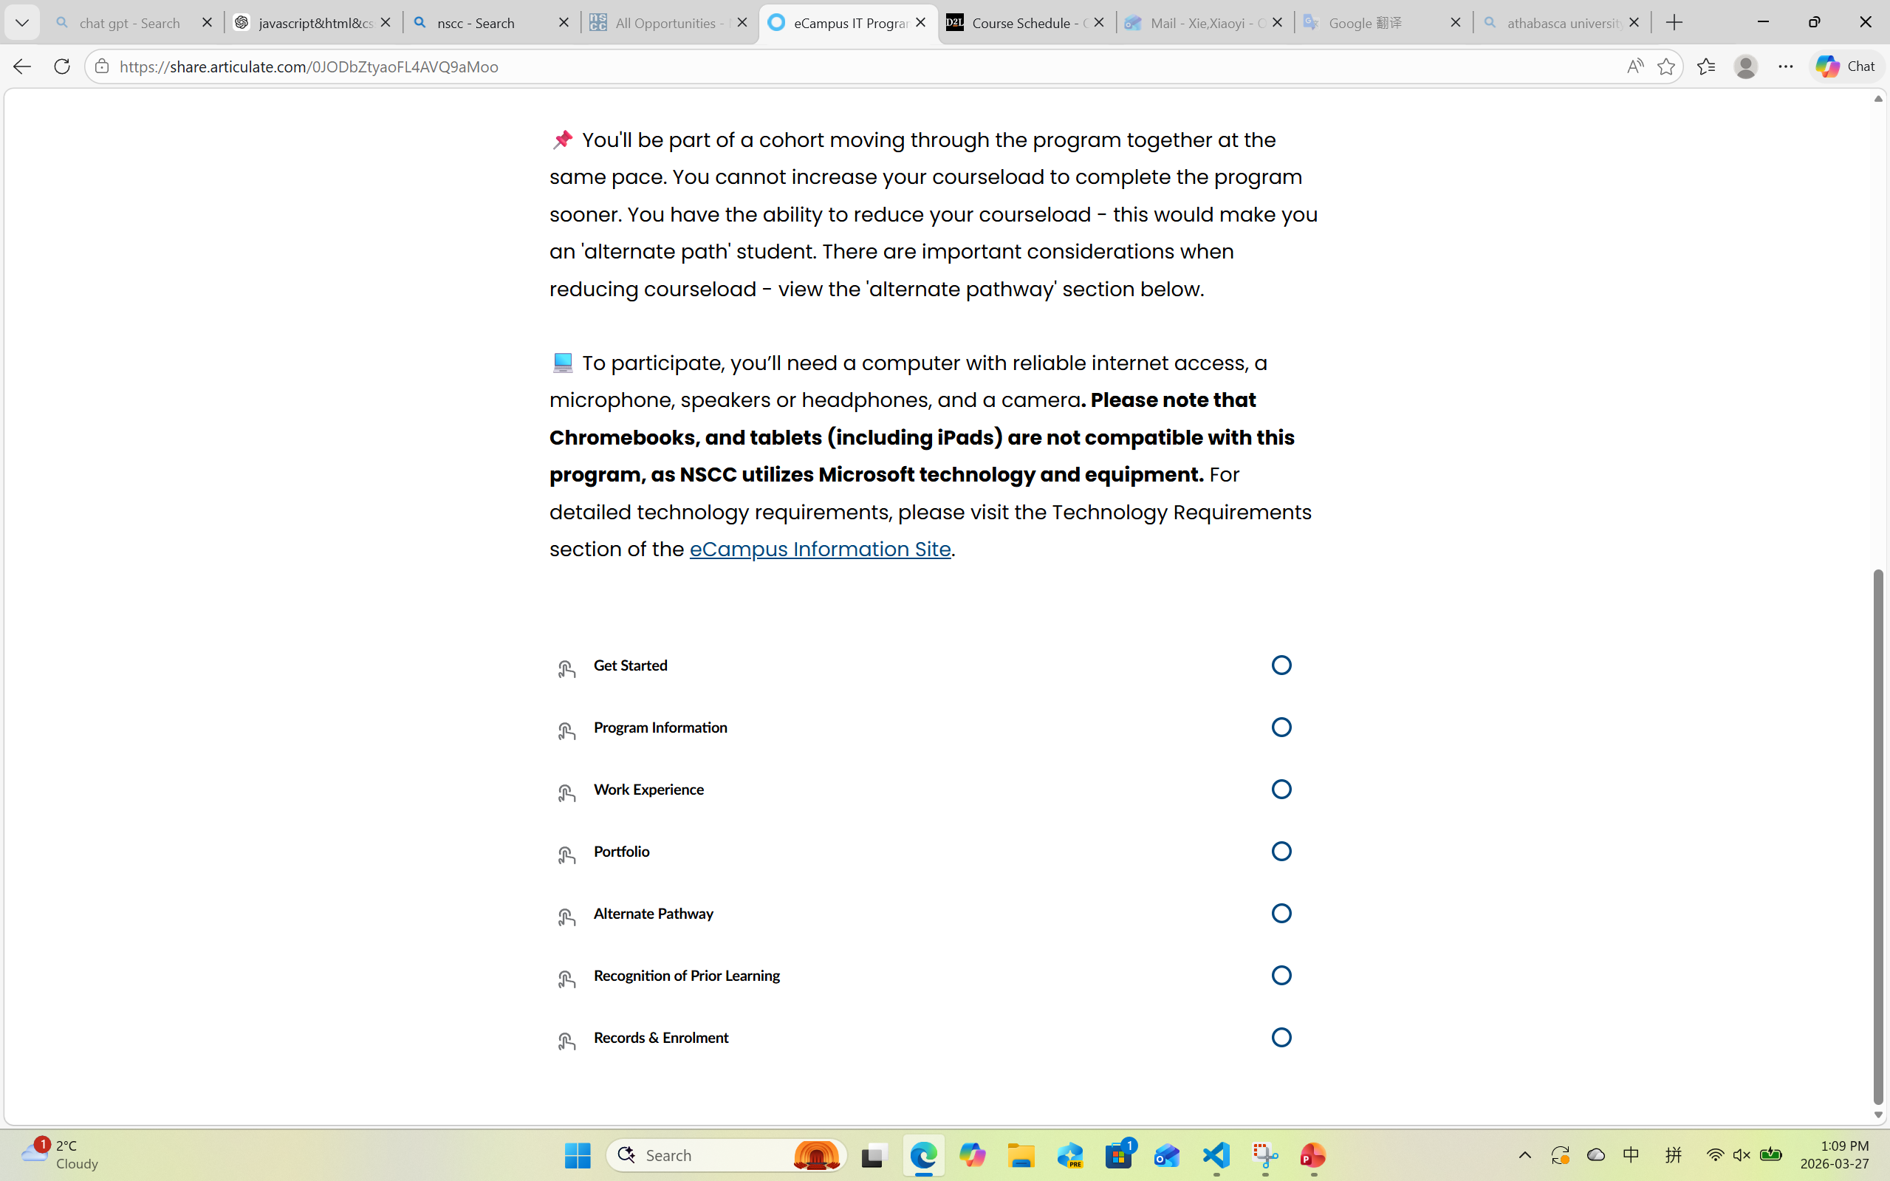
Website Overview
• The website is an online learning platform for IT students
• It provides lessons, resources, and program information
• Users can access videos, PDFs, and course details
• The layout includes a sidebar and main content area
However, the design focuses more on structure than user experience.

Slide 4
Overall Analysis
• The website has a clear structure and simple design • It provides useful learning content for students However, several usability issues exist: • Navigation is not intuitive for new users • Too much scrolling is required to find information • Important content is sometimes hidden • Visual design lacks hierarchy and engagement • Interactive features are inconsistent • Accessibility is limited Overall, the website works, but it is not efficient or user-friendly.

Slide 5
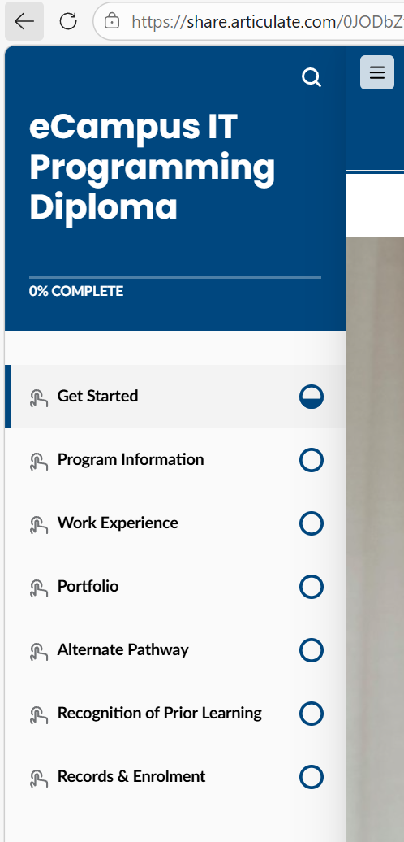
Navigation Structure
• The website uses a sidebar navigation menu
• Users can switch between lessons easily
• Each lesson follows a similar layout
This navigation is not intuitive for first-time users.
This may reduce usability for first-time users.

Slide 6
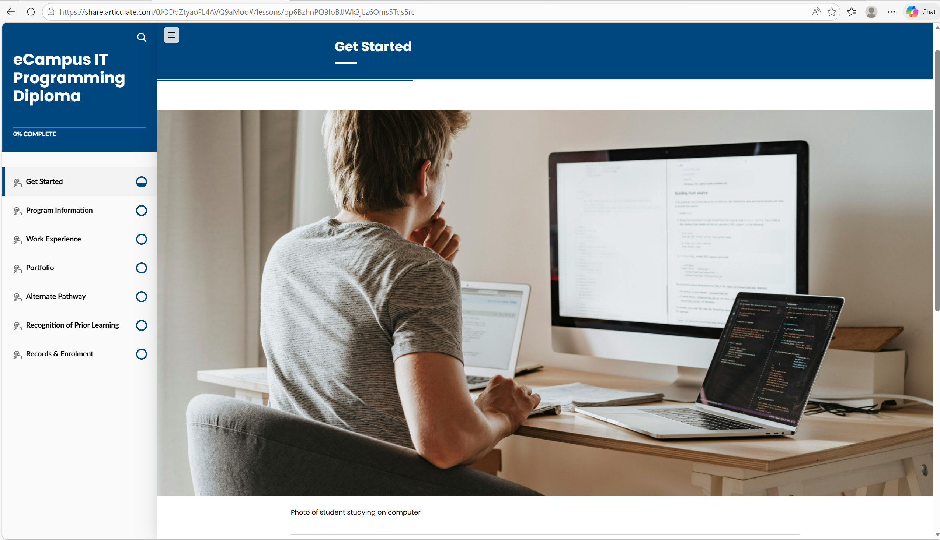
Layout Design
• The layout is divided into navigation and content
• Content is displayed in a vertical format
• Large images are used at the top of each lesson
• This layout is simple, but requires excessive scrolling
This increases user effort and reduces efficiency.

Slide 7
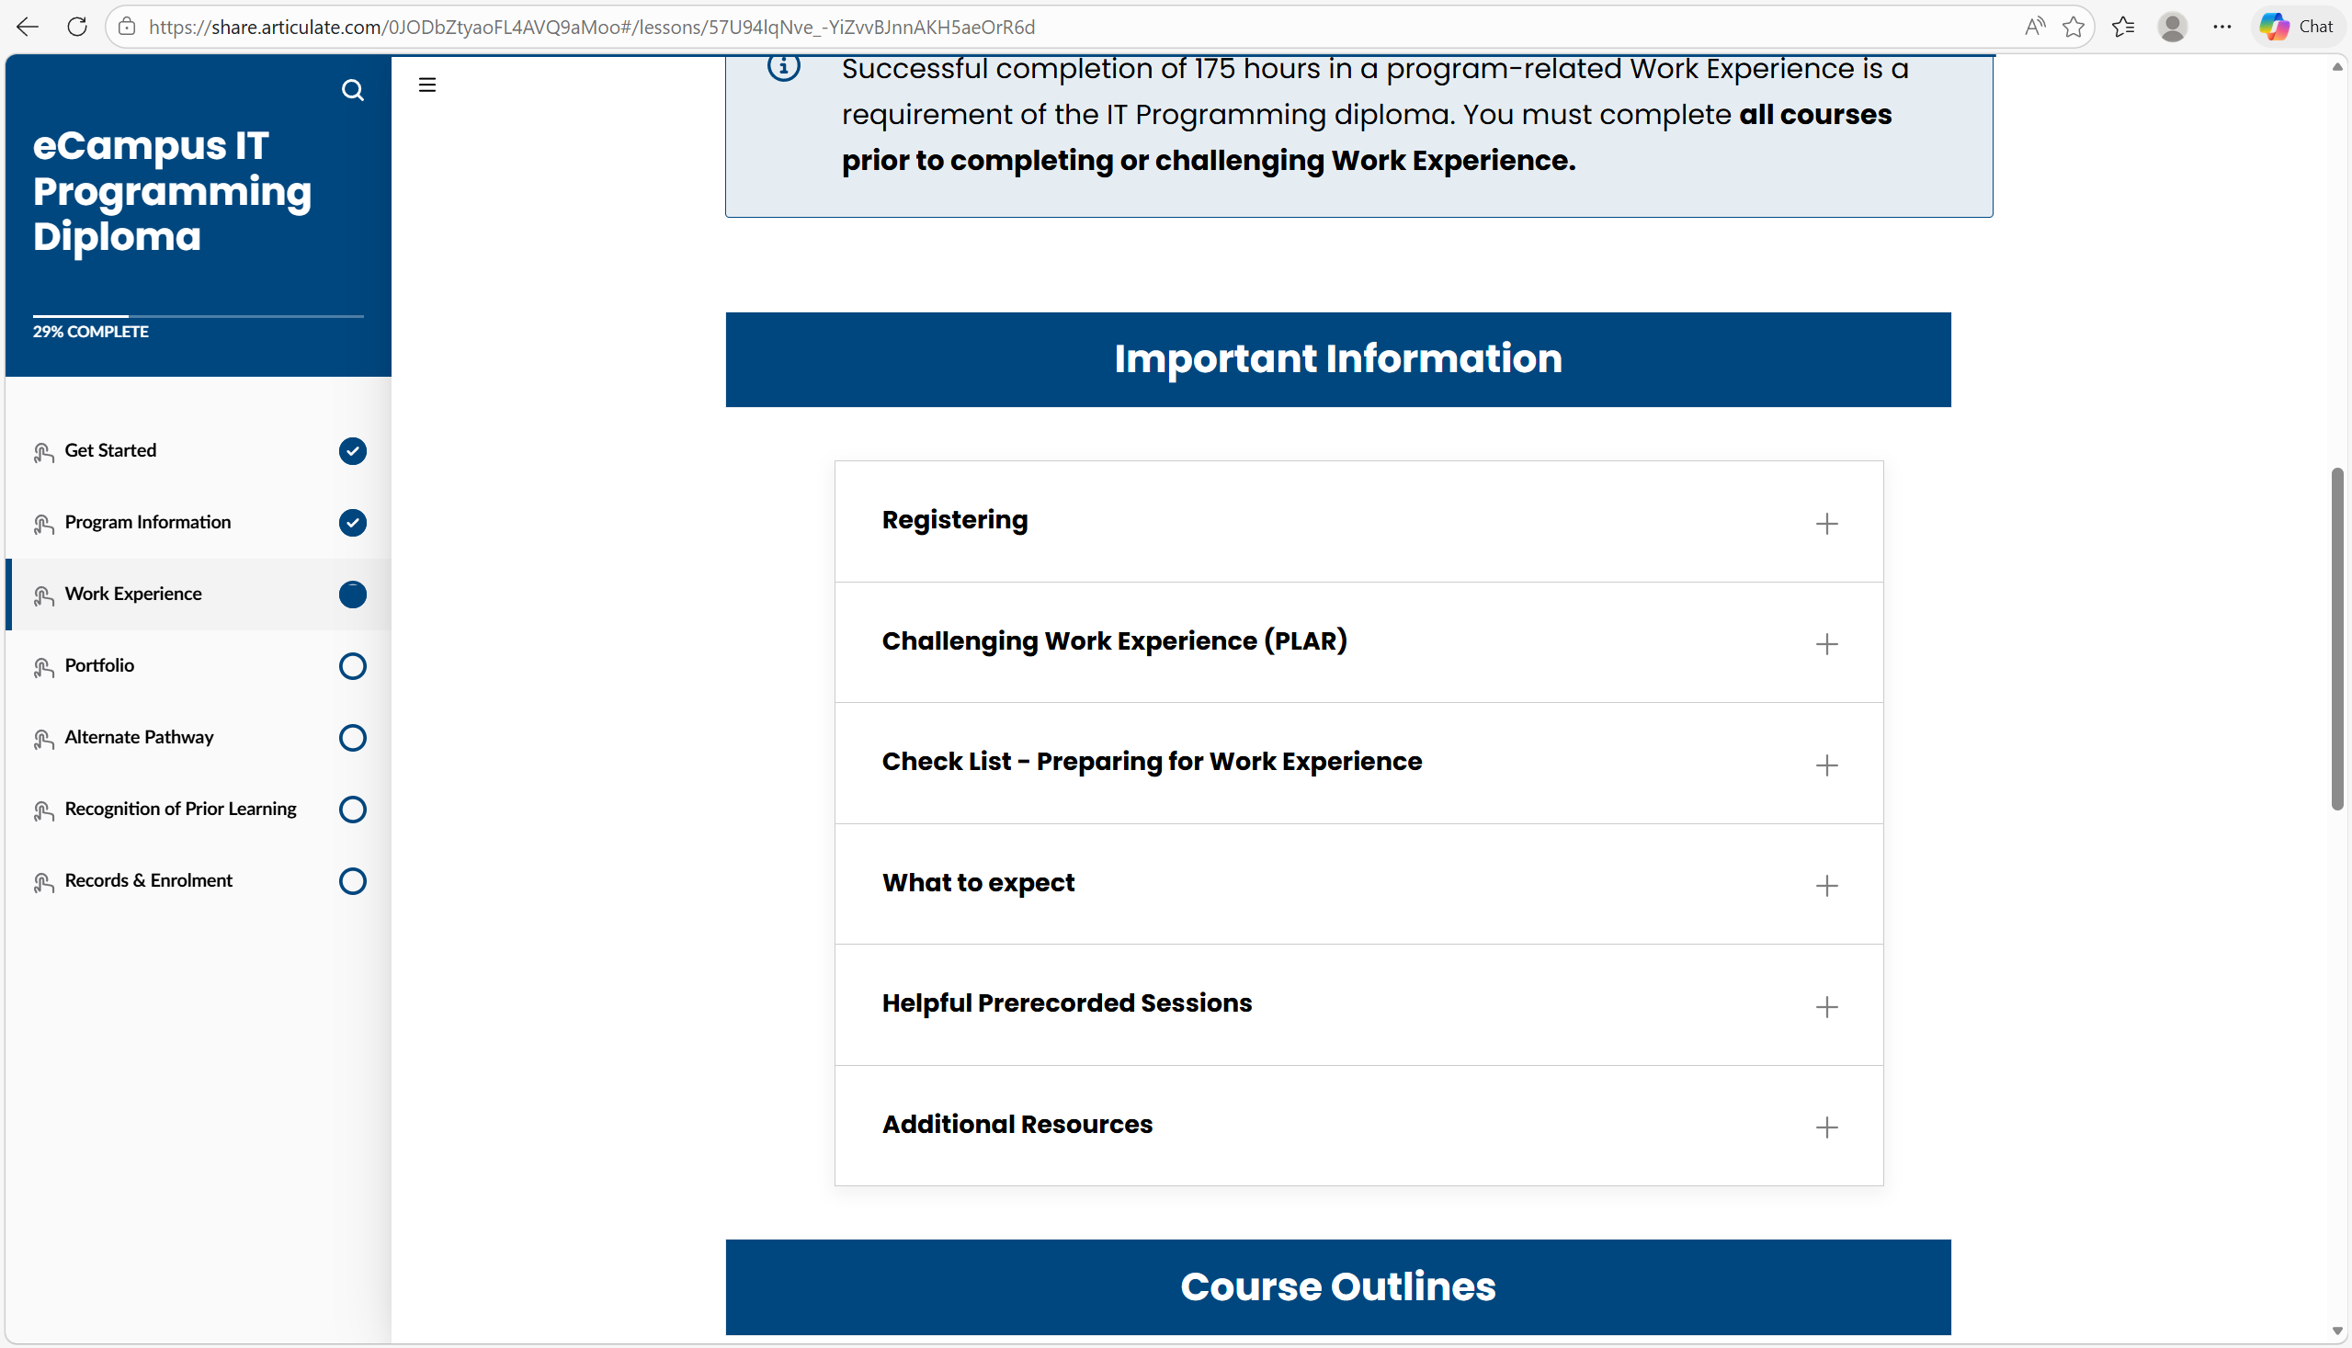
Content Organization
• The website uses expandable sections (+) to show additional content
• This helps reduce clutter and keeps the page visually clean
• Users must click to access detailed information
• This increases interaction effort and slows down navigation
This interaction pattern may reduce efficiency for users.

Slide 8
Visual Design
The design is clean and consistent
However, it lacks visual variety
There is no strong visual hierarchy
The visual design lacks variety and may feel repetitive.
It does not create a strong visual hierarchy.

Slide 9
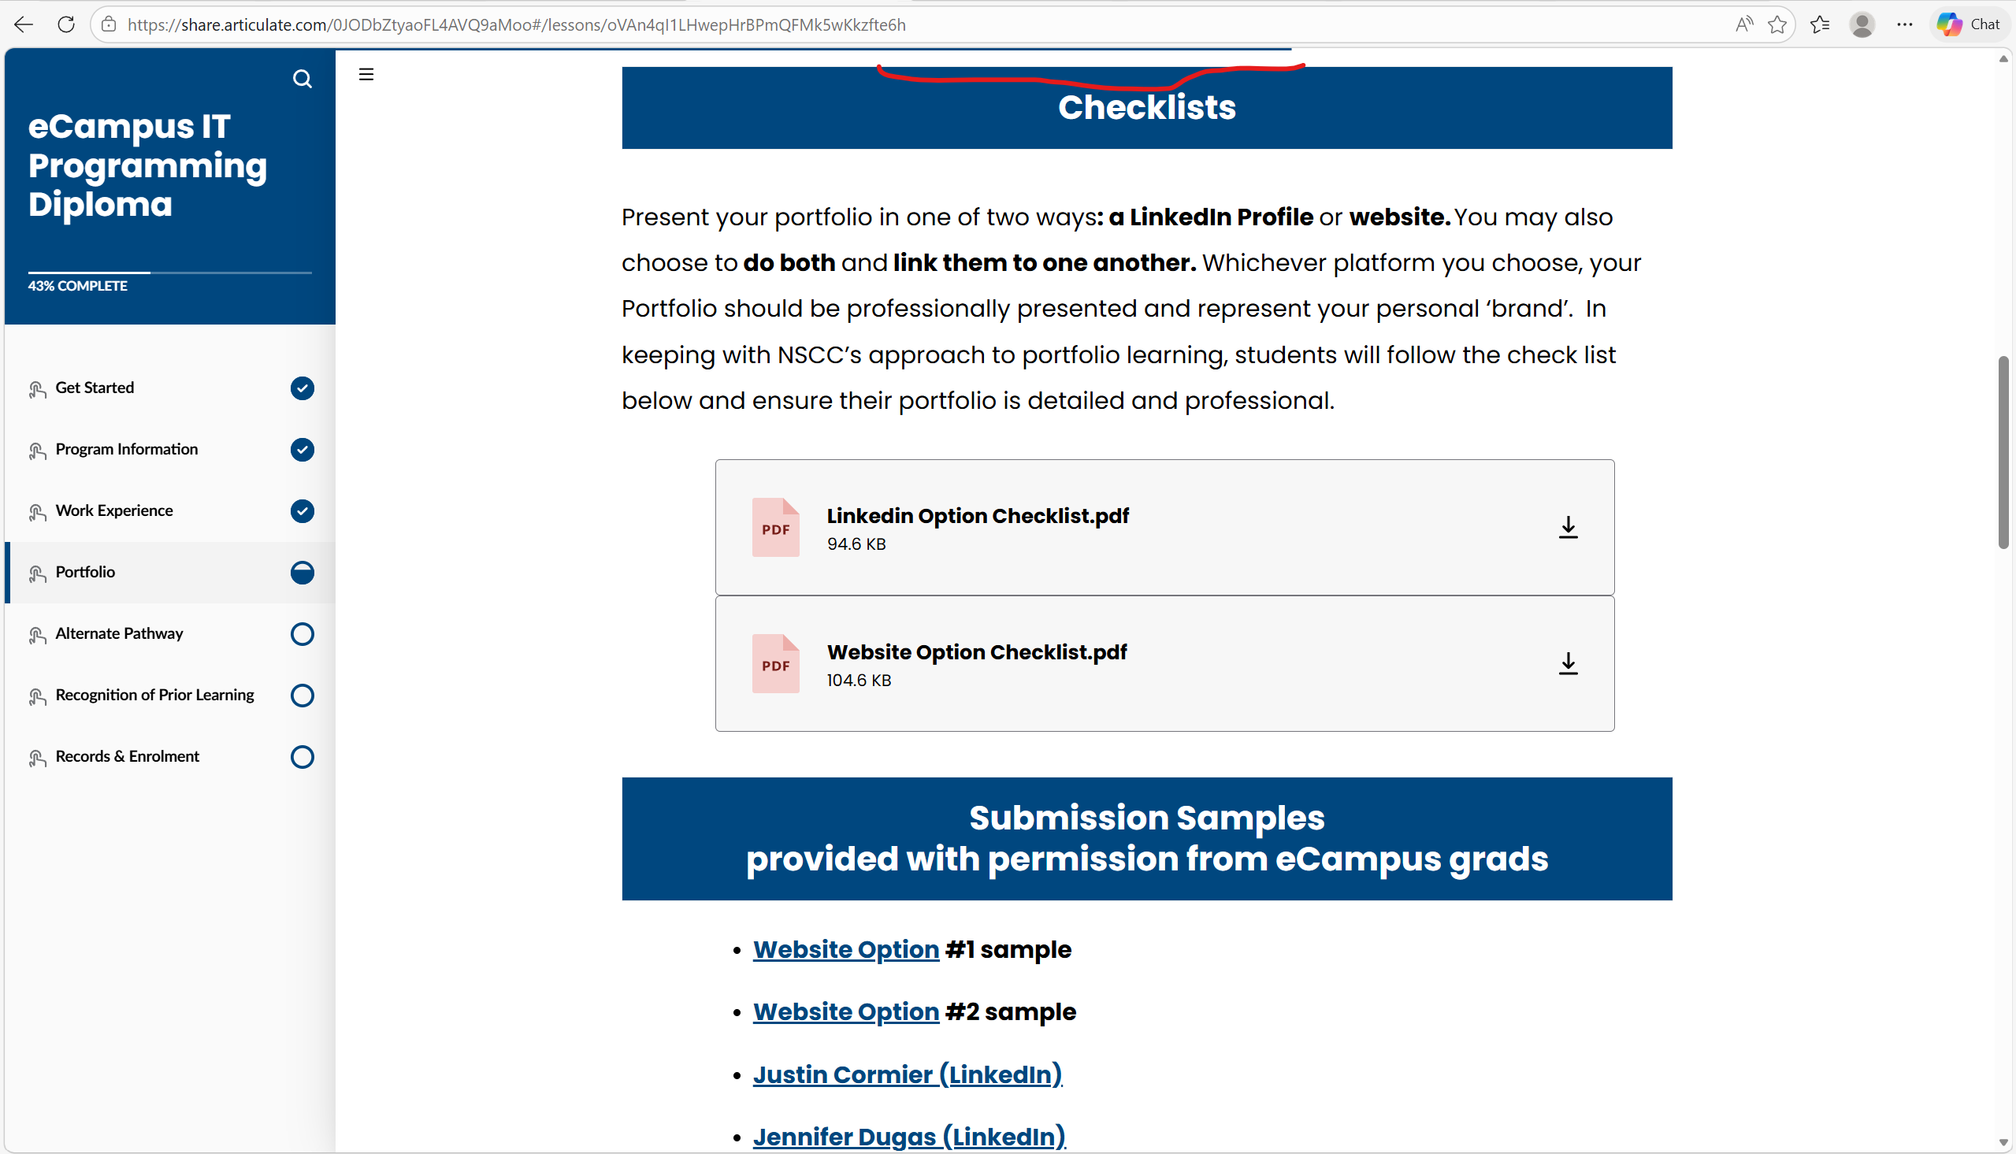
User Experience (UX) / Usability
• The website is easy to use and simple to navigate
• Users can move between lessons using the sidebar
• The progress bar helps users track their learning progress
• However, the website requires a lot of scrolling
• Some features are not obvious for new users
• The interaction is limited and not very engaging
The progress bar provides helpful feedback but is not very noticeable.

Slide 10
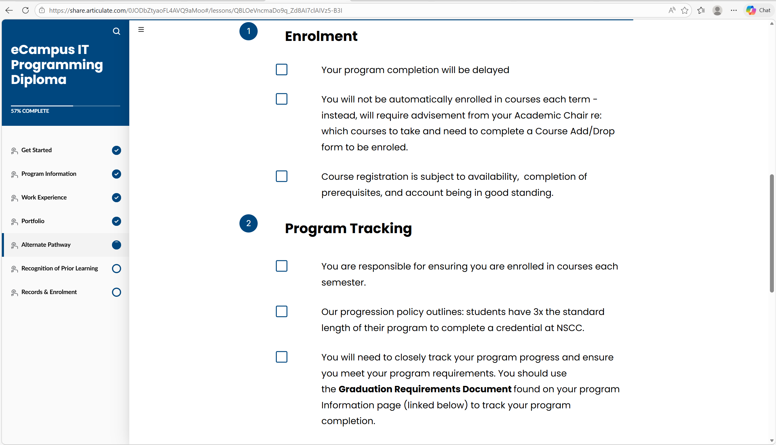
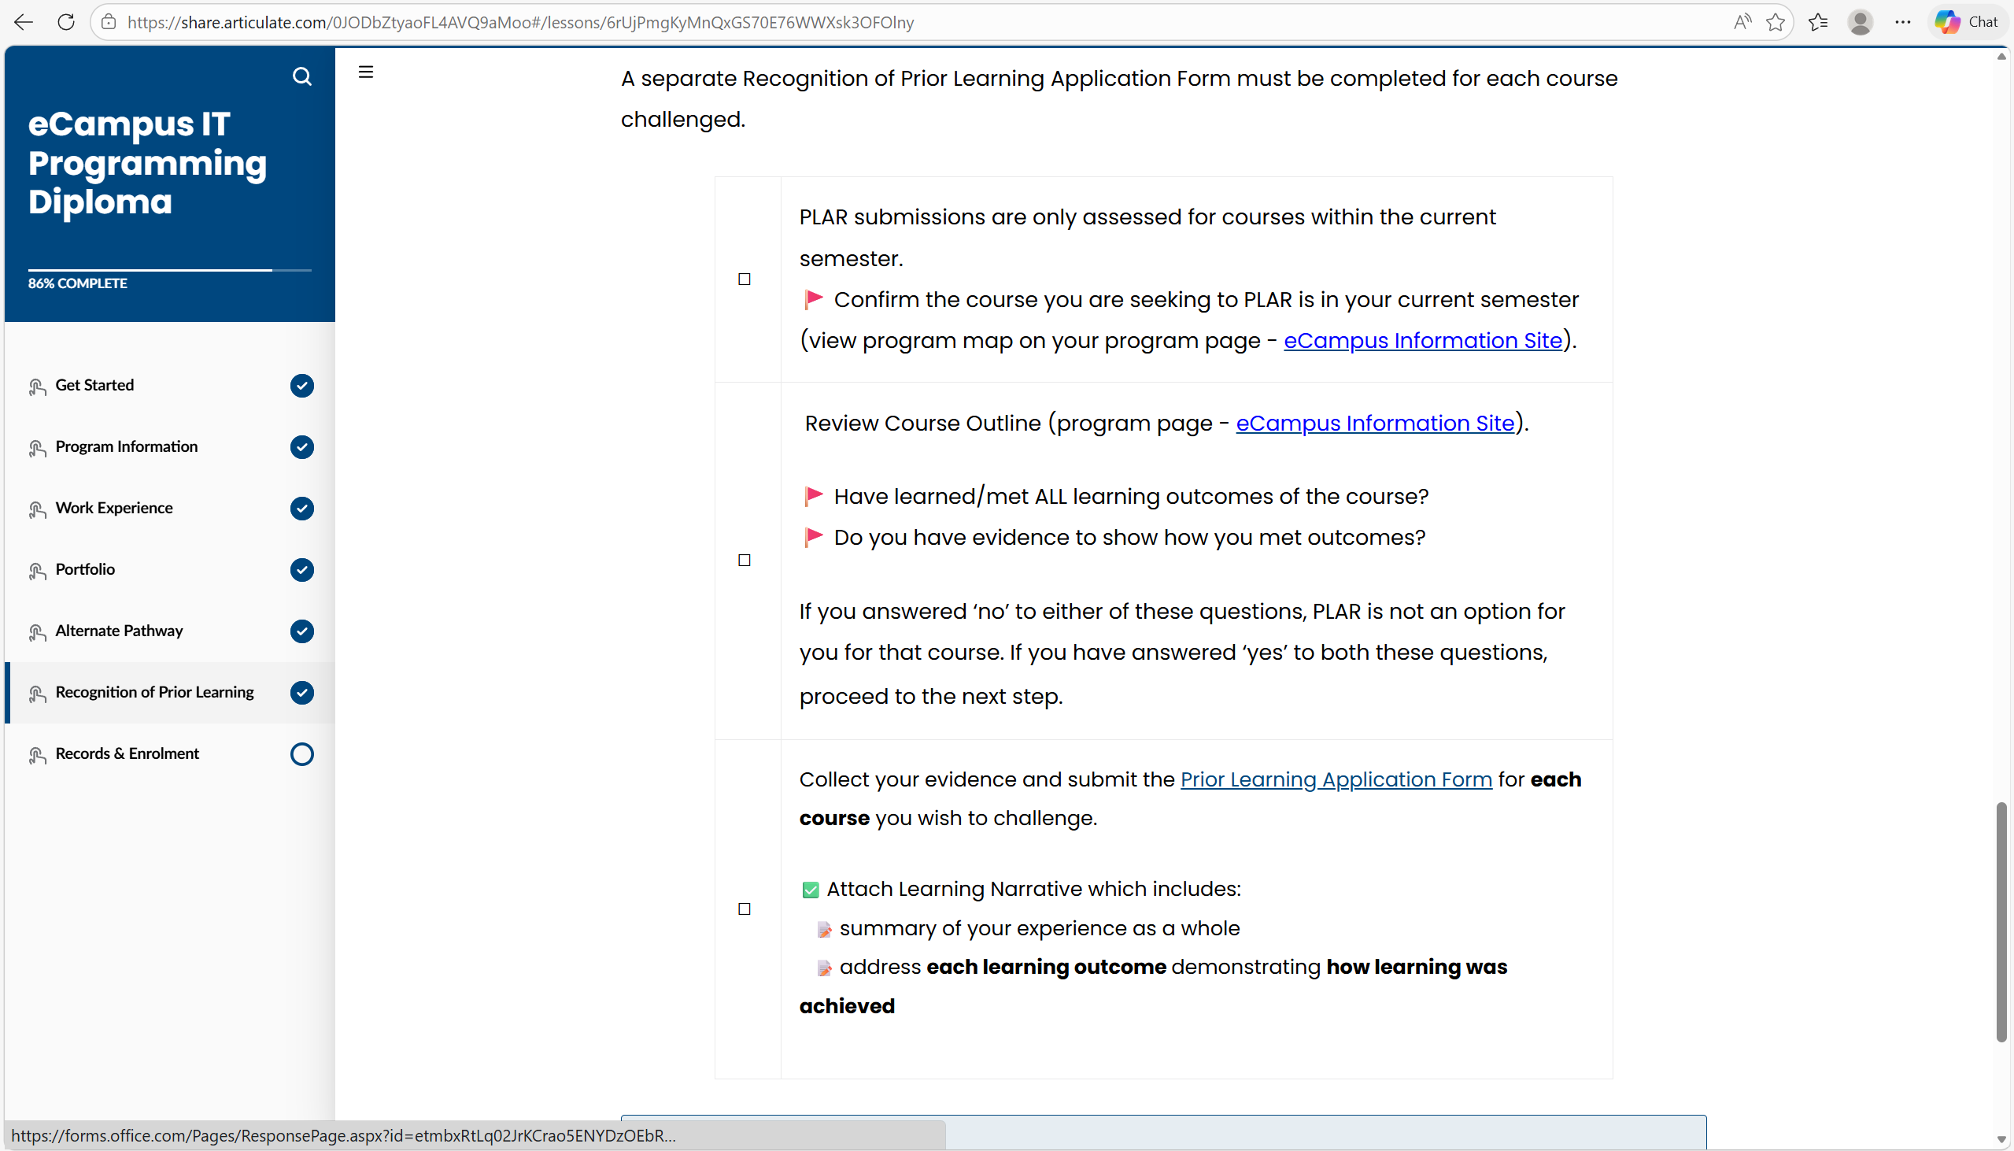
Interactive Features
• The website includes interactive features such as checkboxes and expandable sections
• These features allow users to interact with the content
• Different types of content (videos, PDFs, links) are provided
• However, interaction is inconsistent across lessons
• Some features are not clearly explained
• Users may not understand how to use certain functions
This may reduce usability and cause confusion.
This creates confusion and reduces usability.

Slide 11
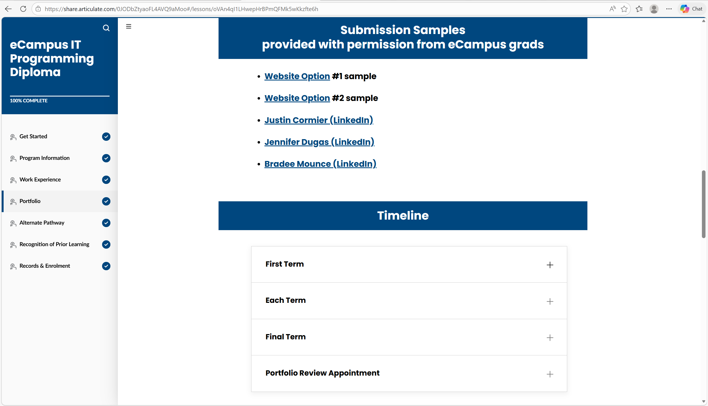
Accessibility
• The original website uses clear text and simple language • Buttons and links are visible, but not always optimized for usability • Some accessibility features are missing or not fully implemented • This may make the website difficult for users with disabilities Improvement: • Better contrast improves readability for all users • Semantic HTML improves screen reader support • Keyboard accessibility allows navigation without a mouse
This redesign makes the website more accessible and inclusive.

Slide 12
Problems Summary
• Navigation is simple but not very intuitive for new users
• Users need to scroll a lot to find information
• Content is sometimes hidden behind expandable sections
• This increases interaction effort and slows down learning
• The visual design is clean but lacks engagement and variety
• Interactive features are inconsistent across lessons
• Some functions are not clearly explained
• Accessibility is limited and not fully implemented
Overall, these issues reduce usability and user experience.

Slide 13
Redesign Goals
• Improve navigation to make it more intuitive for new users
• Reduce excessive scrolling and improve content structure
• Make important information more visible without extra clicks
• Improve consistency of interactive features across lessons
• Enhance visual design to make the website more engaging
• Create a clearer visual hierarchy to guide user attention
• Improve accessibility by using better contrast and clearer descriptions
These changes aim to create a more efficient and user-friendly experience.

Slide 14
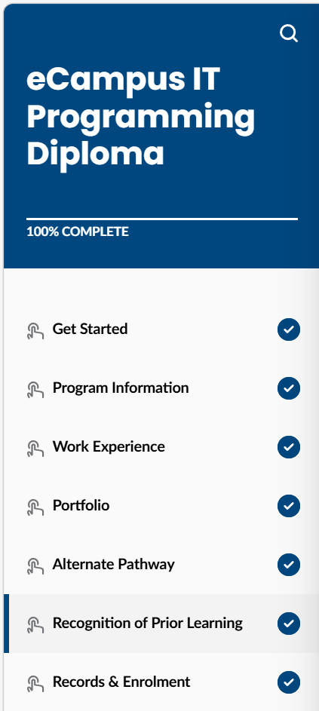
Navigation Improvement
• Make the sidebar clearer and easier to understand
• Highlight the current lesson
• Add a top navigation bar
• Add a “Back to Top” button
• Help new users understand how to navigate
These changes improve usability and user experience.
Highlight current lesson
Add top navigation
Add "Back to Top"

Slide 15
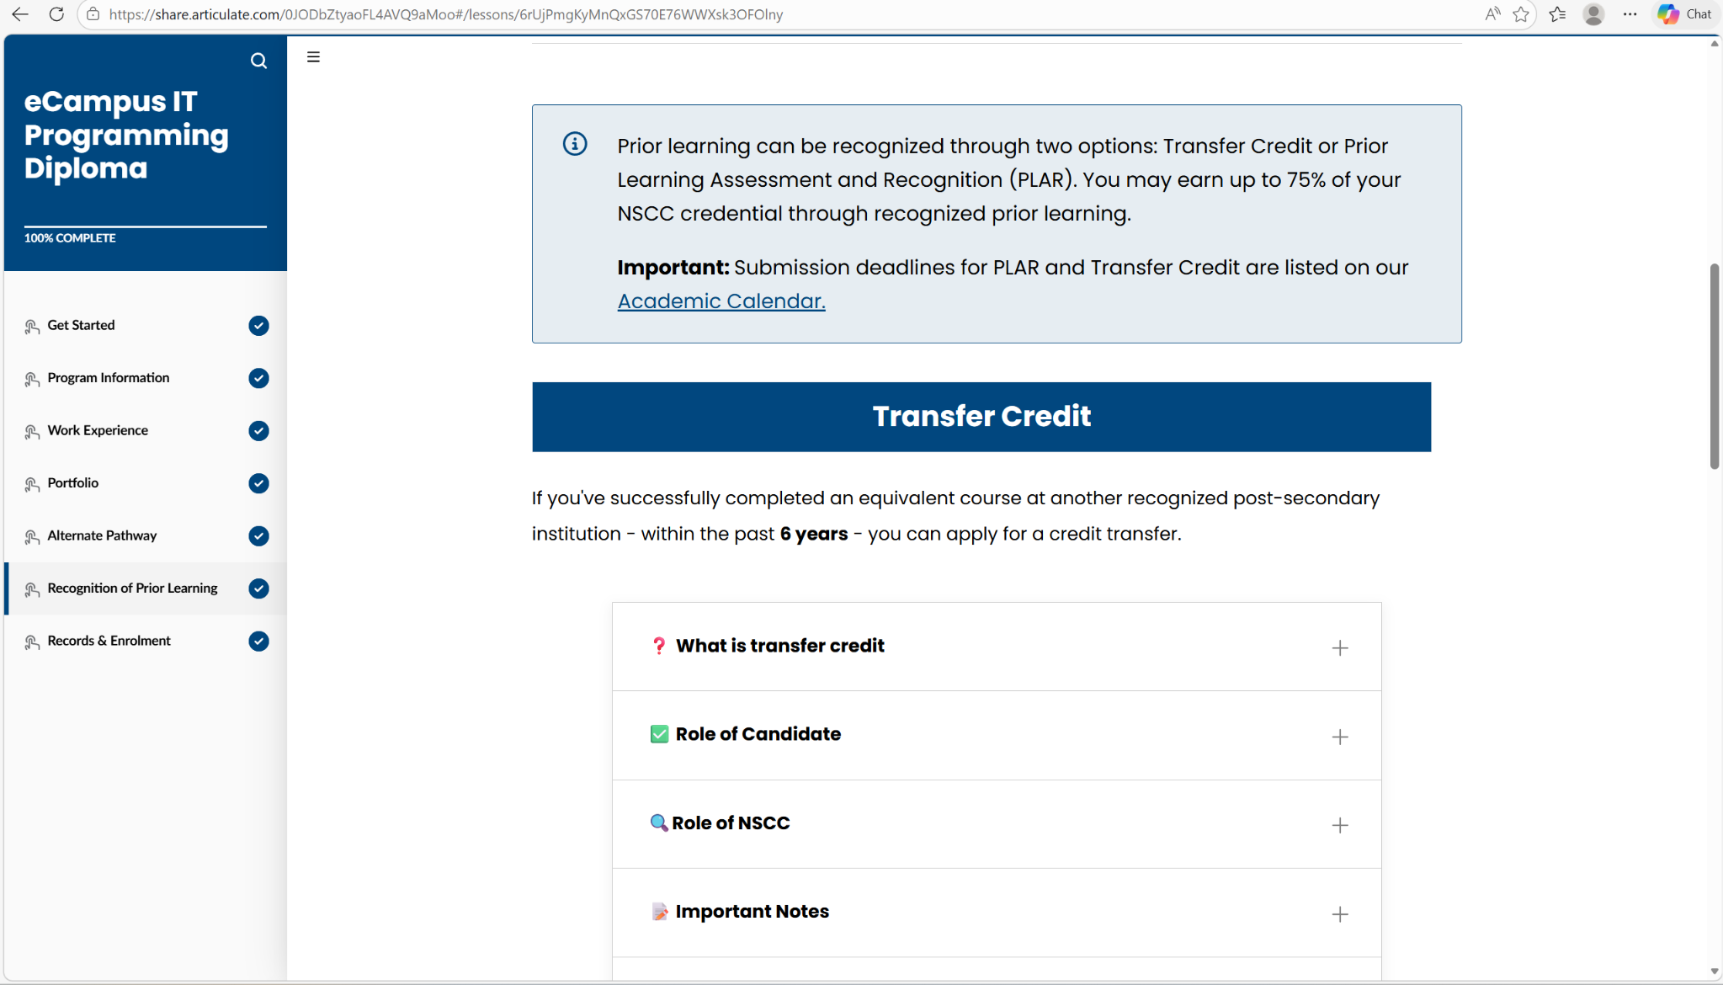
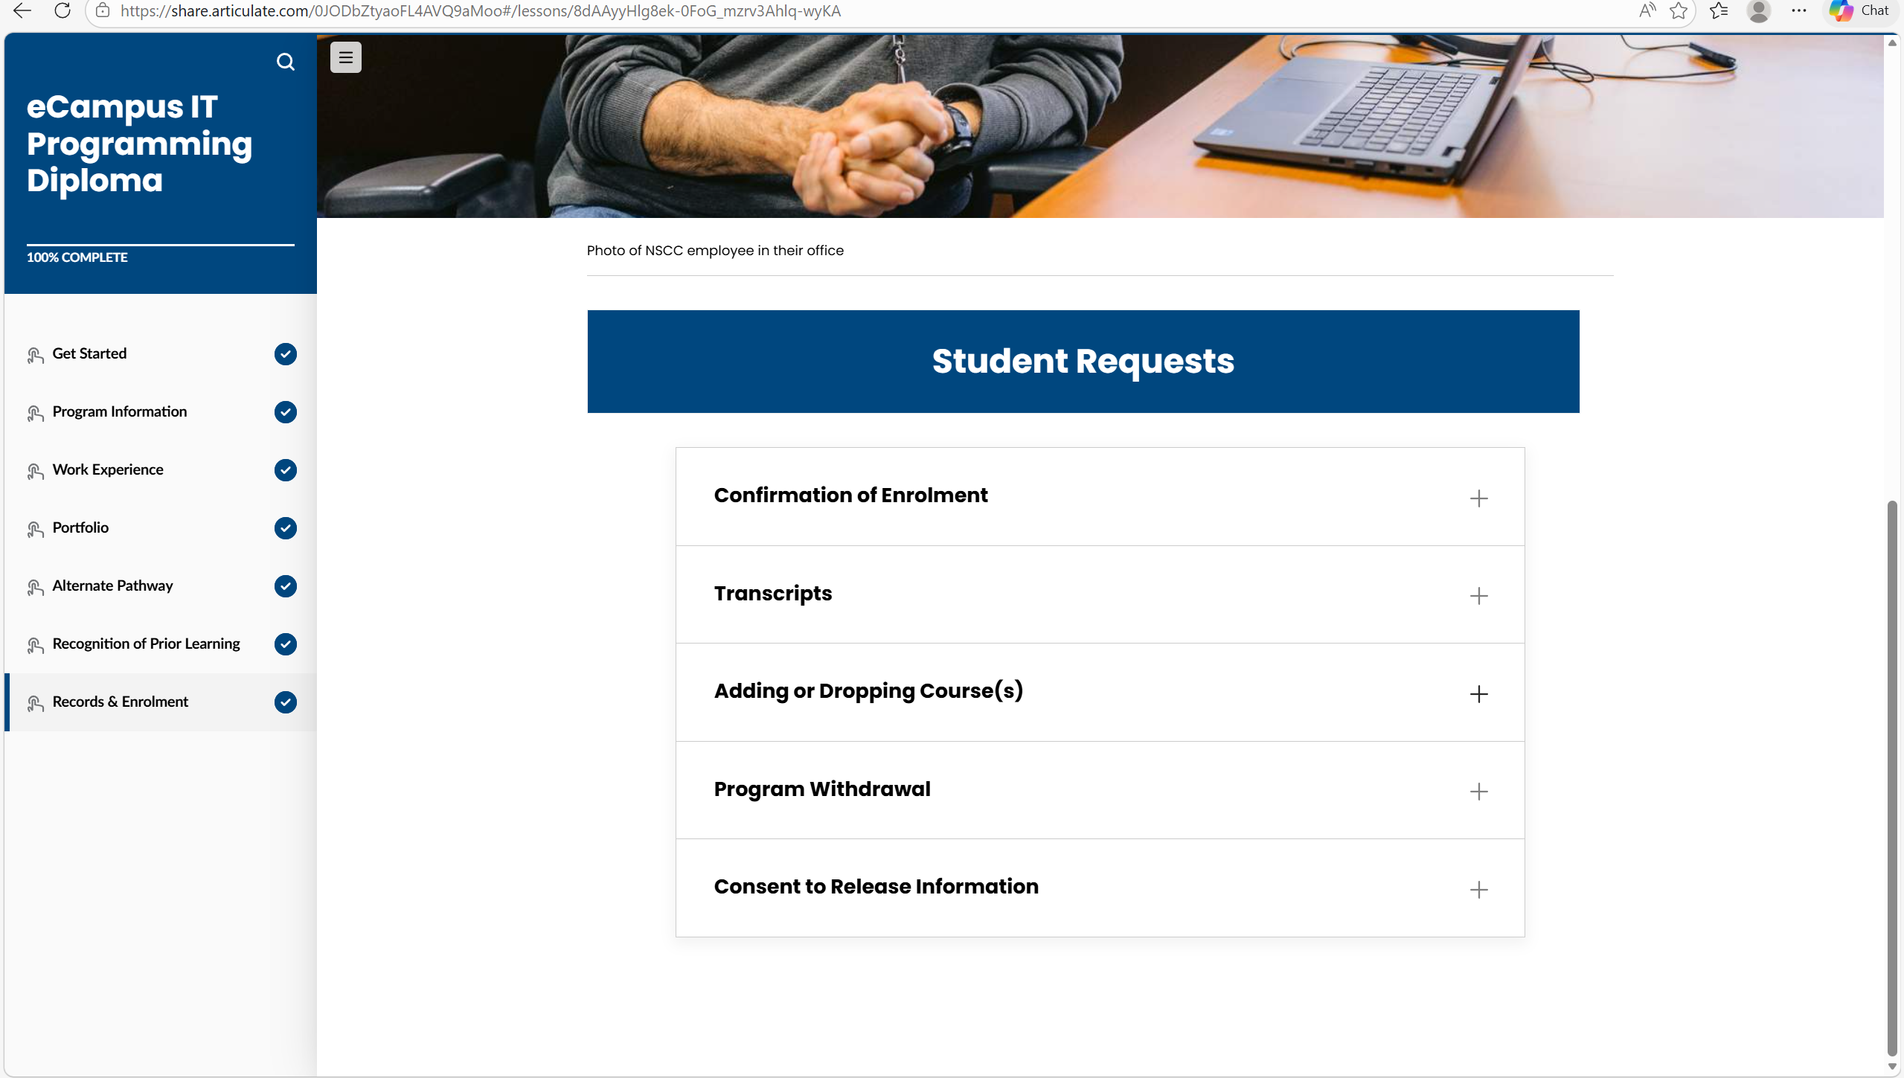
Content / Scrolling Improvement
• Show important information without extra clicks
• Reduce the use of expandable sections
• Break content into smaller sections
• Add clear headings to organize information
• Reduce long scrolling pages
These changes make content easier to read and faster to access.

Slide 16
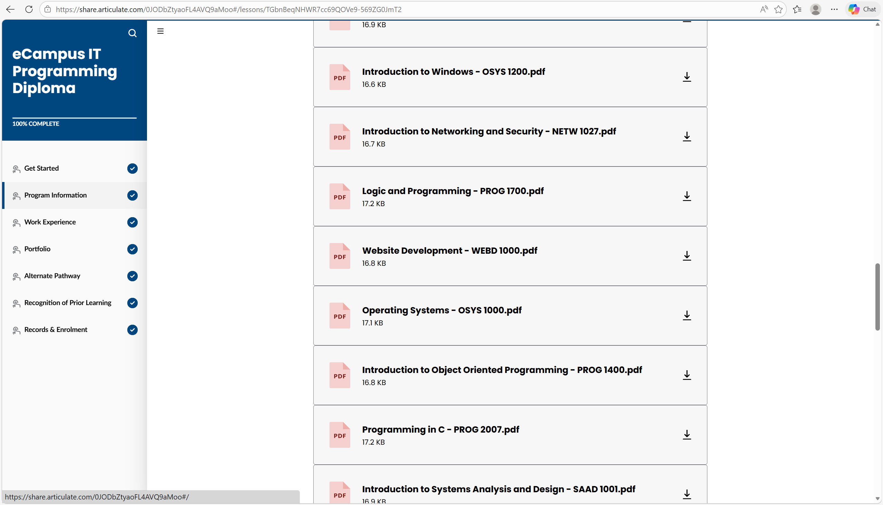
Visual Design Improvement
• The design is repetitive, so add more colors and visual elements
• Too many similar items make scanning difficult, so use spacing and grouping
• Important content is not highlighted, so use color or icons
• There is no strong visual hierarchy, so use titles and section contrast
These changes make the website more engaging and easier to scan.

Slide 17
Redesign Demonstration (Code Improvements)
This project includes 3 small redesign demos:
1. Sidebar Navigation
- Clear menu structure
- Highlighting of active sections
- Easier navigation
2. Content Organization
- Direct display of important information
- Card-style layout for easier reading
- Reduced clicks
3. Accessibility Improvements
- Improved color contrast
- Clearer titles and buttons
- Easier to read and use
All code is commented and explained in detail in the README.md file.

Slide 18
Final Proposed Design
• The new design optimizes navigation, making it easier for users to switch between different sections.
• A clearer structure and layout make important information easier to find.
• Content is more organized, reducing scrolling.
• Visual design has been improved, with optimized hierarchy, spacing, and emphasis.
• Interactions across all pages are more consistent.
• Higher contrast and clearer elements enhance website usability.
• The redesigned website better adapts to different screen sizes (responsive design).
The redesigned website will provide a more efficient, convenient, and user-friendly experience.

